Slide 1
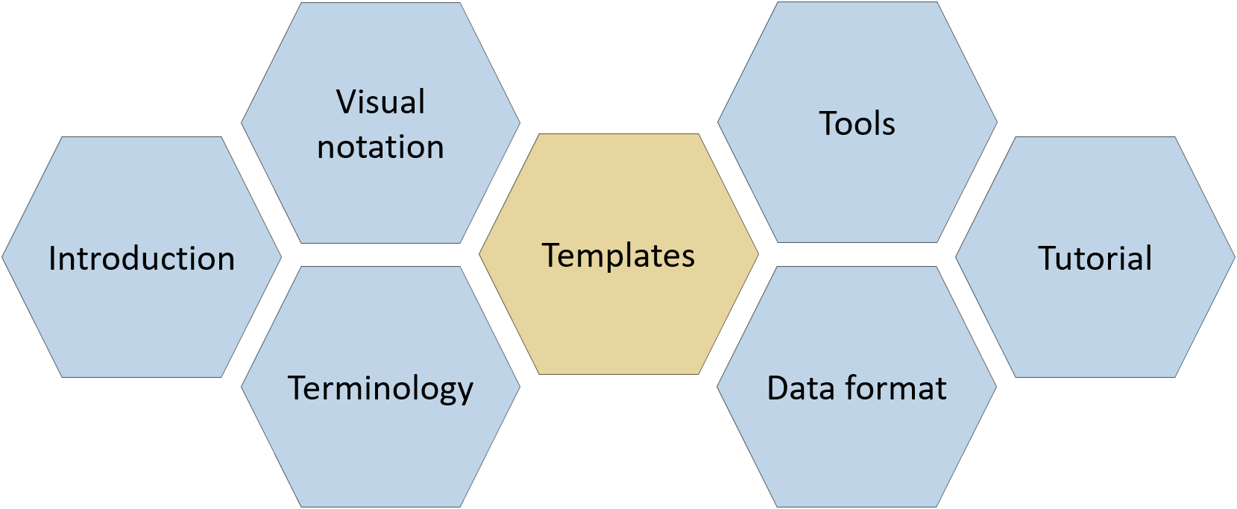

Diagram templates
CJML – Customer Journey Modeling Language
Version 3.0 • June 2026
SINTEF Digital

Slide 2
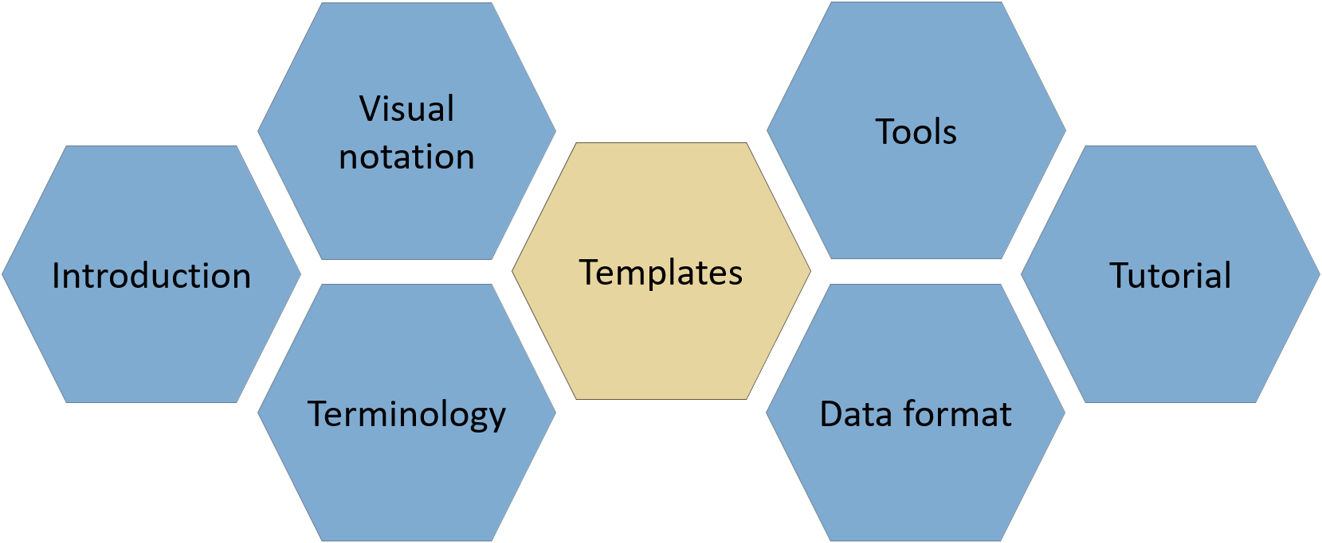

About
CJML consists of several modules, each covering a different aspect of the language. All resources are available at www.cjml.no
Diagram types, symbol gallery, visual features, and examples
Tools for creating and working with journeys
Overview of CJML, its conceptual foundation, and a quick tour of the visual notation
Guidance on journey thinking, journey data, approaches to analysis, and use cases
Definitions, metamodel, class diagrams, and model attributes
Machine-readable model structure, XML format, and data exchange
PowerPoint templates for quick, flexible diagramming with examples
Contact us: For questions or feedback, contact us at CJML<at>sintef.no
CJML v3 was developed as part of the research project Smart Journey Mining, funded by the Research Council of Norway (grant no. 312198).
How you may use this material: © SINTEF, licensed under
CC BY-SA 4.0. You may use, share, and adapt it with attribution, with adaptations shared under the same license.

Slide 3



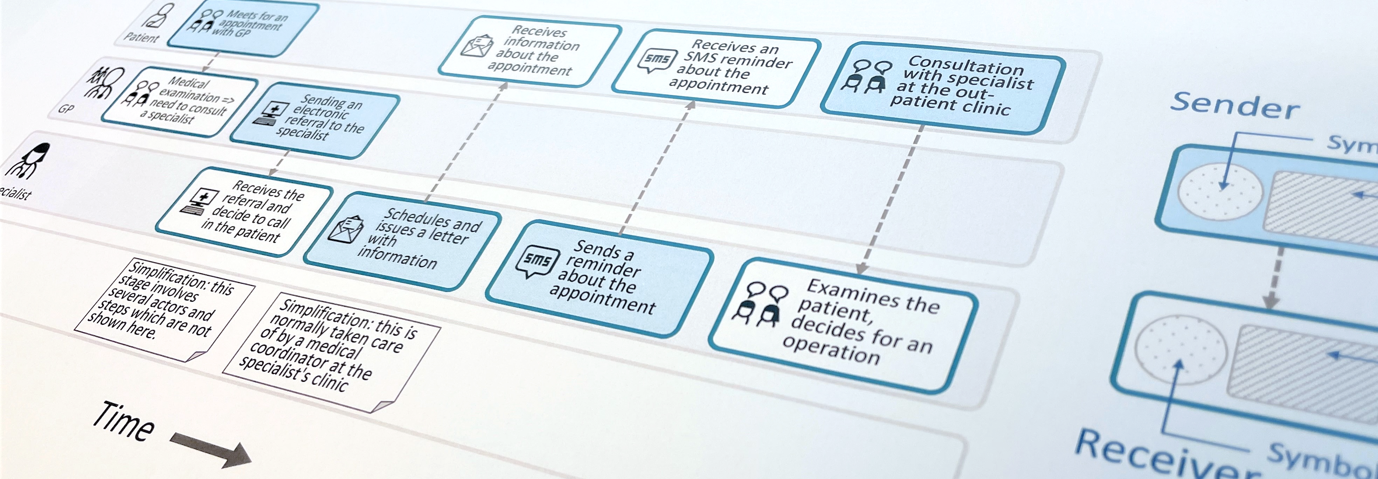
Customer Journey Modeling Language
CJML is a visual language for modeling the journey of an individual, regardless of whether the person has the role of customer, user, employee, patient, or citizen.
CJML consists of terminology, visual notation, a machine-readable data format, methods, and supporting tools
Customer journey
User journey
Employee journey
Patient journey
Citizen journey
3

Slide 4
Content
Quick overview
Symbol gallery
  Core and healthcare symbols
  Special symbols: Cybersecurity and data privacy
Templates – customer journey diagram
  Planned journey – variable length
  Actual journey – variable length
  Compliance and deviation diagram
  User experience and phase
Templates – journey network diagram
  N=3 actors | comment field | user experience
  N=4 actors | comment field | user experience
  Compliance and journey phase
  Healthcare | comment field | patient experience
  Cybersecurity
  Data privacy
Examples – customer journey diagram
  Online bookstore: planned journey
  Online bookstore: actual journey
Examples – journey network diagram
  Online bookstore: planned journey
  Online bookstore: actual journey
  Healthcare: referral to a specialist
  Healthcare: booking difficulties
  Cybersecurity
  Data privacy
4

Slide 5

Quick overview
Diagram types - planned journey
Diagram types - actual journey
Comparison through example

Slide 6

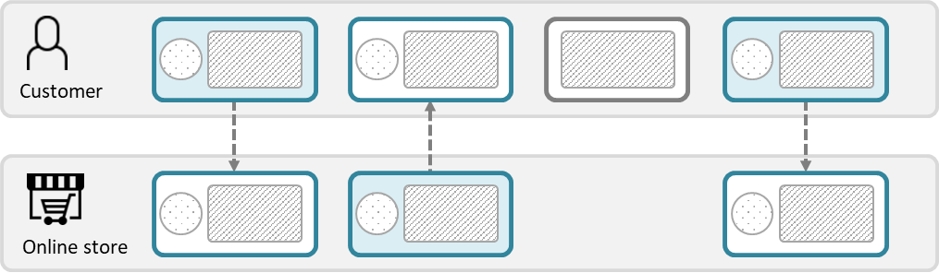
Diagram types – planned journey
Customer journey diagram
Suitable when focusing only on the end-user
Suitable when few actors are involved
Journey network diagram (“swimlane diagram”)
Suitable when several actors are involved
Reveals both the sender and the receiver of a communication point
Emphasizes the direction of the message flow
The boundary colours are free of choice, but must be consistent (representing the initiating actor).
This diagram has two predefined colours, distinguishing the initiator from the receiver.
There is an implicit time axis running from left to right
Time
💡
CJML distinguishes between touchpoints that communicate a message (circle) and those that do not (square).
6

Slide 7
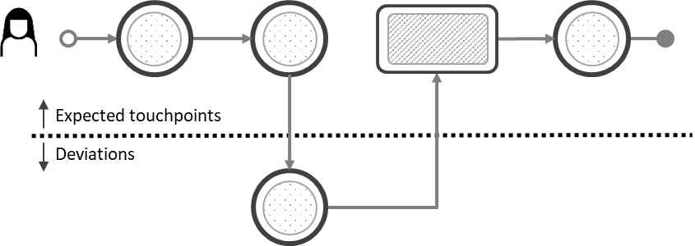
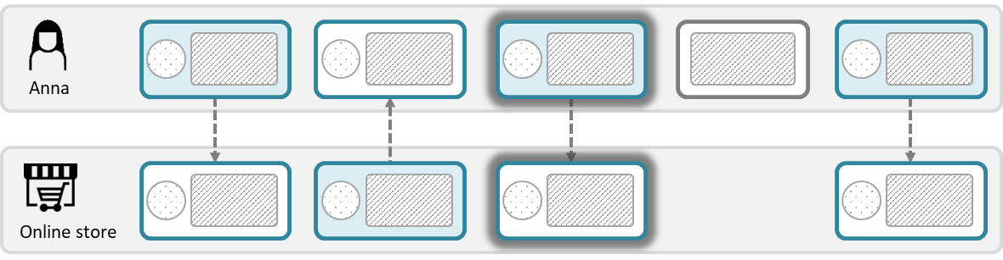
Diagram types – actual journey
Customer journey diagram
Suitable when focusing only on the end-user
Suitable when few actors are involved
Suitable when emphasizing deviations from the planned journey
Journey network diagram (“swimlane diagram”)
Suitable when several actors are involved
Reveals both the sender and the receiver of a communication point
Emphasizes the direction of the message flow
💡
Ad-hoc touchpoints also appear differently in the two diagram types.
7

Slide 8
Comparison through an example
💡
This example is used to compare the two diagram types. The next slide shows the diagrams.
A customer orders books through an online bookstore. The bookstore coordinates the payment with a financial partner, who sends an invoice to the customer. After payment, the bookstore sends the package to the customer.
Planned journey (as envisioned by the bookstore)
Actual journey (Tom, a fictitious character)
T1: The customer orders books online through the bookstore’s web application.
  T1.1: The bookstore receives the order and forwards it to their financial partner. (This step is not part of the customer’s journey.)
T2: The financial partner sends the invoice to the customer.
T3: The customer pays the invoice
T3.1: The financial partner confirms the payment to the bookstore (This step is not part of the customer’s journey.)
T4: The customer receives the package in the mailbox.
T1: Tom orders books online through the bookstore’s web application..)
T2: Tom receives the invoice from the financial partner.
  D2.1: Tom discovers a hidden delivery fee when reviewing the invoice.
  D2.2: Tom calls the financial partner to clarify the fee. He realizes that he overlooked the fee when ordering but is dissatisfied because it was not presented more clearly.
T3: Tom pays the invoice.
T4: Tom receives the package in his mailbox.
Deviations

Slide 9
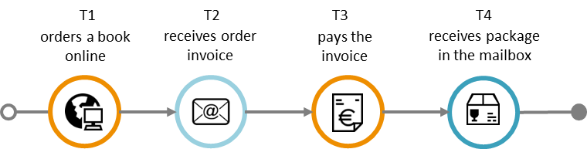
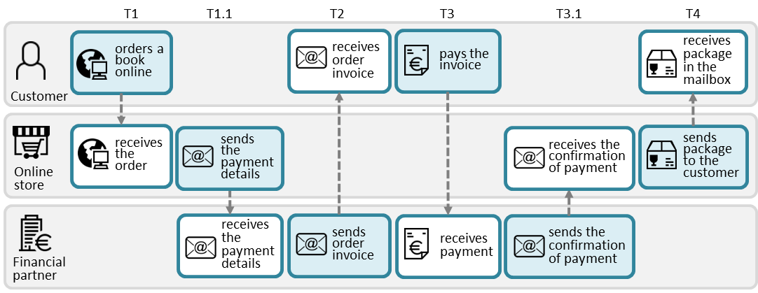
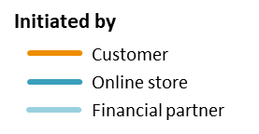
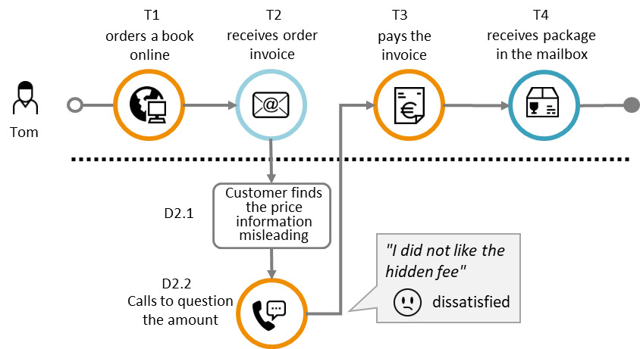
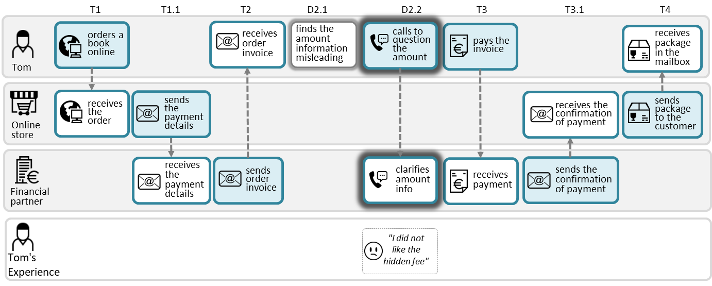
Online bookstore example shown with both diagram types.
Customer Journey Diagram
Journey Network Diagram
Planned journey
The planned journey for a typical customer. This diagram only shows the touchpoints encountered by the customer and corresponds to the upper swimlane to the right.
Planned journey
The network diagram includes two touchpoints (i.e., T1.1 and T3.1) which are invisible to the customer, however necessary to “produce” the customer’s next touchpoint.
💡
See the Examples section for editable templates.
Actual journey
The actual customer journey for Tom, a fictitious character. Tom’s journey contains an unexpected call which is emphasized in this deviation diagram.
Actual journey
The actual customer journey for Tom, a fictitious character. Tom’s journey contains an unexpected call which is emphasized in the diagram.
9

Slide 10
Symbol gallery
About the use of symbols
Actors and customer experience
Communication channels
Healthcare symbols
Cybersecurity symbols
Data privacy symbols

Slide 11


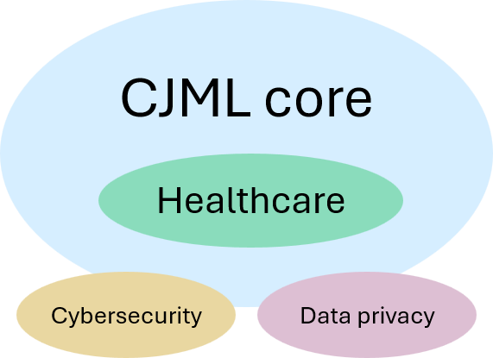
About the use of symbols
The symbols are used mainly for three purposes:
  To represent actors
  To represent communication channels
  To represent end user experience.
Symbols for communication channels
  CJML provides a set of preferred symbols, as well as alternatives.
Actor symbols are provided for various contexts:
  General service context (core)
  Healthcare (core)
  Cybersecurity
  Data privacy.
Some special-purpose symbols are also provided.
Actor
Citizen
Communication channel
E-mail
Customer experience
Dissatisfied

Slide 12





























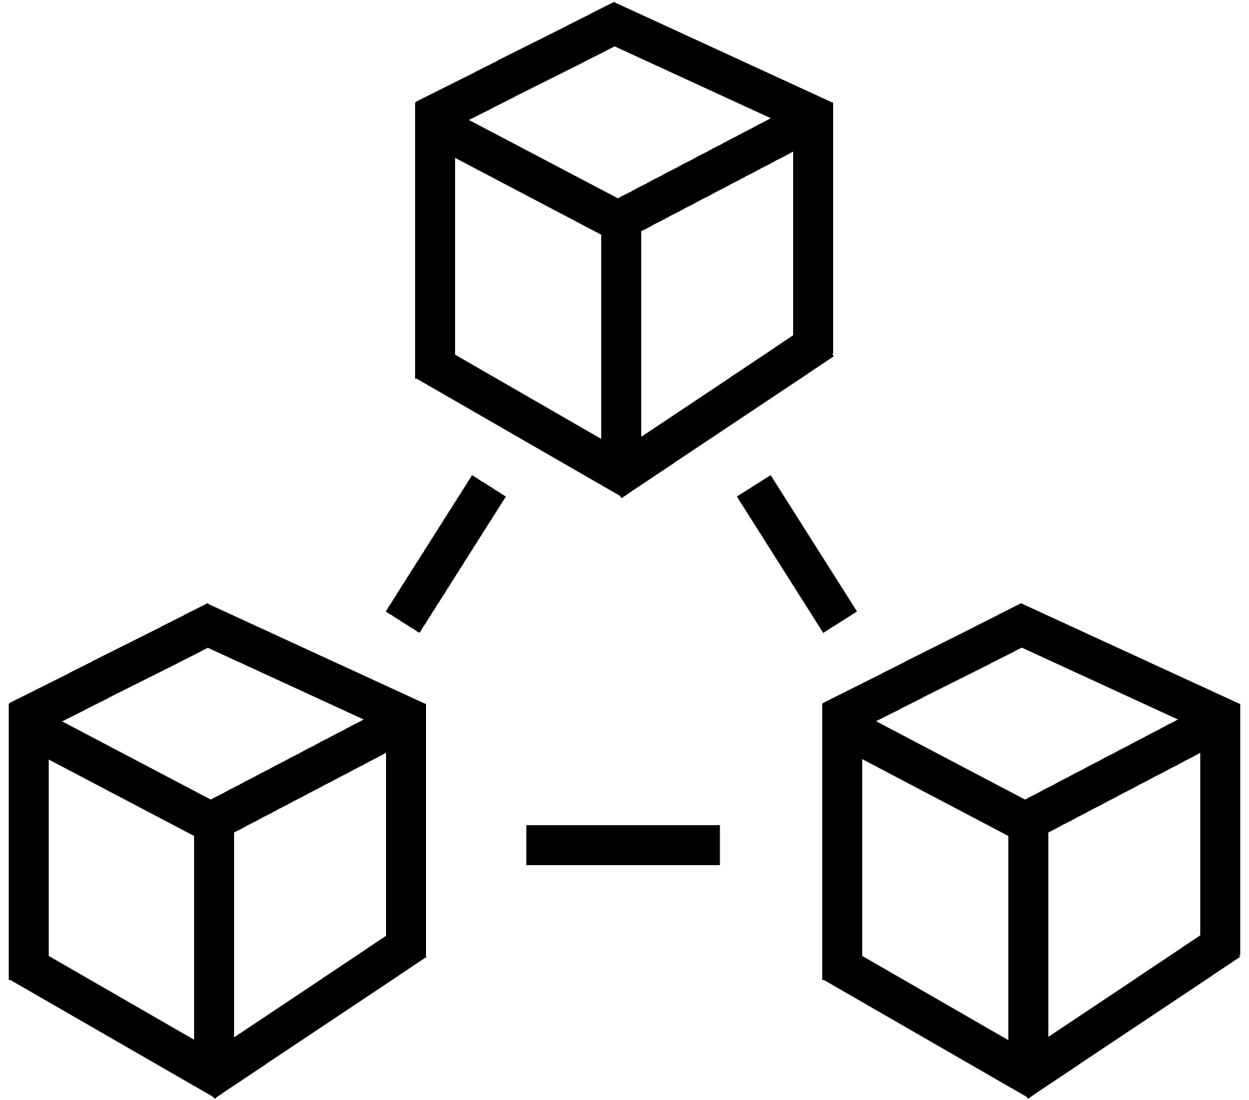





Actors and customer experience
Core
Users and customers
user1
user2
user3
user4
user5
user6
user7
user8
Service providers
service provider1
service provider2
service provider3
service provider4
service provider5
store1
store2
store3
online store1
bank1 online
bank2 online
bank3
bank4
bank5
bank6
Employee - general
employee1
employee2
employee3
employee4
employee5
employee6
IT staff and technicians
staff IT1
staff IT2
staff3 IT3
staff tech1
staff tech2
staff tech3
Platforms and systems
Customer experience
tech1 database
tech2 database
tech3 server
tech4 virtual machine
tech5 cloud
tech6 network
tech7 system
tech8 system cloud
1 very dissatisfied
2 dissatisfied
3 neutral
4 satisfied
5 very satisfied
12

Slide 13
















Communication channels
Core
telephone conversation
face-to-face interaction
payment channel
SMS
shop counter
letter
e-mail
service desk
self-service machine
chat
social media message
fax message
package delivery
message service
internet/globe
app on smartphone
internet via smartphone
unknown channel
app on PC
internet via PC
app on tablet
internet via tablet
13

Slide 14






Additional symbols
Additional
Communication channels
social-media-
message-2
face-to-face-2
face-to-face-3
payment-channel-2
payment-channel-3
payment-channel-4
Invoice
Actors
user9
user10
user11
user12
user13
user14
14

Slide 15


















Healthcare actors and channels
Healthcare
Patients
Healthcare systems
patient-1
patient-2
patient-3
patient-4
hospital-computer-system
hospital-post-office
Doctors and surgeons
Health secretaries
doctor-1
doctor-2
doctor-3
doctor-4
health-secretary-1
health-secretary-2
secretary-receptionist-1
secretary-receptionist-2
Nurses
Communication channels
nurse-1
nurse-2
nurse-3
nurse-4
chief-nurse
Health-portal
on-PC
Health-portal-
on-smartphone
Medical record
Hospitals and health systems
hospital-1
hospital-2
hospital-3
hospital-4
15

Slide 16








































Additional healthcare symbols
Additional
Actors
Channels
doctor - general practitioner
doctors
surgeons
anesthesiologists
nurses
chief nurses
health secretaries
secretaries/receptionists
medical practices
patient-medical-record-2
patient-medical-record-3
16

Slide 17














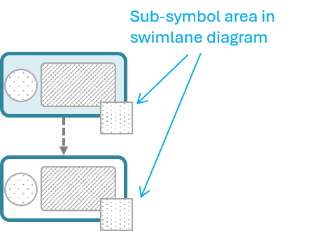
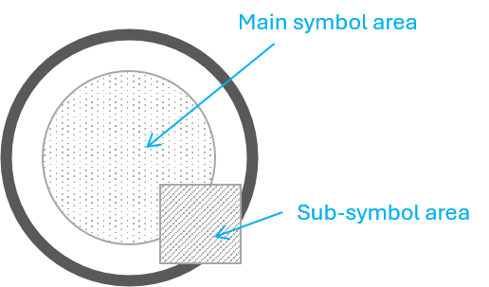






Cybersecurity symbols
Cybersecurity
Cybersecurity experts
Cybersecurity expert 1
Cybersecurity expert 2
Cybersecurity expert 3
Cybersecurity expert 4
Cybersecurity expert 5
Cybersecurity expert 6
Cybersecurity expert 7
Cybersecurity expert 8
Cybersecurity expert 9
Attackers / cybercriminals
attacker
attacker network
attacker physical
attacker software
attacker social engineering
Special symbols (used as touchpoint sub-symbols)
threat
unwanted incident
vulnerability lock
vulnerability unlock
firewall
danger2
17

Slide 18



Data privacy symbols
Data privacy
Special symbols
Touchpoint with sub-symbols
Data collected
Data processed
Data shared
Privacy Comment
A dedicated swimlane for data privacy comments
DC: Description of data collected + purpose
DP: Description of data processed + purpose
DS: Description of data shared + purpose
DC: Description of data collected + purpose
DP: Description of data processed + purpose
DS: Description of data shared + purpose
DC: Description of data collected + purpose
DP: Description of data processed + purpose
DS: Description of data shared + purpose
DC: Description of data collected + purpose
DP: Description of data processed + purpose
DS: Description of data shared + purpose
DC: Description of data collected + purpose
DP: Description of data processed + purpose
DS: Description of data shared + purpose
Privacy
Comment

Slide 19
Templates - Customer journey diagram
Planned journey – variable length
Actual journey – variable length
Compliance and deviation diagram
User experience and phase

Slide 20







Planned journey
Color = initiator of the touchpoint.
Symbol area (channel)
💡
Insert and connect the touchpoints (communication points and actions). Add a short description and a symbol for the communication channel (communication points only).
T1
T2
T3
T4
<Insert a short description>
<Insert a short description>
<Insert a short description>
<Insert a short description>
Planned journey, no Actions
Customer
Service providers
💡
Who initiates the touchpoint? Select the corresponding actor color.
T1
T2
T3
T4
<Insert a short description>
<Insert a short description>
<Insert a short description>
Planned journey with Action
<Description of
the action>
💡
These are the most common channel symbols. See the Symbol gallery for a full overview.
20

Slide 21
Planned journey – variable length
T1
T2
T3
T4
T5
<Insert a short description>
<Insert a short description>
<Insert a short description>
<Insert a short description>
<Insert a short description>
5 touchpoints
T1
T2
T3
T4
T5
T6
<Insert a short description>
<Insert a short description>
<Insert a short description>
<Insert a short description>
<Insert a short description>
<Insert a short description>
6 touchpoints
T1
T2
T3
T4
T5
T6
T7
<Insert a short description>
<Insert a short description>
<Insert a short description>
<Insert a short description>
<Insert a short description>
<Insert a short description>
<Insert a short description>
7 touchpoints
21

Slide 22
Actual journey
Color = initiator of the touchpoint.
Symbol area (channel)
💡
Select a suitable actor symbol. See the Symbol Gallery for a full overview.
T1
T2
T3
T4
<Insert a short description>
<Insert a short description>
<Insert a short description>
<Insert a short description>
Actual journey, no Actions
Customer
Service providers
💡
Who initiates the touchpoint? Select the corresponding actor color.
T1
T2
T3
T4
<Insert a short description>
<Insert a short description>
<Insert a short description>
Actual journey with Action
<Description of
the action>
💡
These are the most common channel symbols. See the Symbol gallery for a full overview.
22

Slide 23
Actual journey – variable length
T1
T2
T3
T4
T5
<Insert a short description>
<Insert a short description>
<Insert a short description>
<Insert a short description>
<Insert a short description>
5 touchpoints
T1
T2
T3
T4
T5
T6
<Insert a short description>
<Insert a short description>
<Insert a short description>
<Insert a short description>
<Insert a short description>
<Insert a short description>
6 touchpoints
T1
T2
T3
T4
T5
T6
T7
<Insert a short description>
<Insert a short description>
<Insert a short description>
<Insert a short description>
<Insert a short description>
<Insert a short description>
<Insert a short description>
7 touchpoints
23

Slide 24
Compliance - deviation diagram
Compliance can be addressed in case of actual journeys when you have knowledge about the planned journey.
In case of a deviation, the touchpoint is put below the broken line.
The circle's boundary style indicates the status of the communication point
  Solid boundary: completed as expected (above the line) or ad-hoc (below the line).
  Dashed boundary: missing.
  Crossed touchpoint: failing.
Completed and ad-hoc
Missing
Failing
Examples
T1
T2
T3
T4
T5
<Insert a short description>
<Insert a short description>
<Insert a short description>
<Insert a short description>
Actual journey
Customer fails to buy a train ticket
Customer didn’t receive the call
Expected touchpoints
Deviations
D1
<Insert a short description>
24

Slide 25
User experience and phase
Detailed template for deviations and user experience
Phase 1
Phase 2
T1
T2
T3
T4
T5
User experience
<Insert a short description>
<Insert a short description>
<Insert a short description>
<Insert a short description>
<Insert a short description>
Text based on the user’s self-reported feedback
<Insert a short description>
Rating (text)
Emoticon
D2.1
<Insert a short description>
very
dissatisfied
very
satisfied
dissatisfied
satisfied
neutral
D2.2
<Insert a short description>
25

Slide 26
Templates – journey network diagram
N=3 actors | comment field | user experience
N=4 actors | comment field | user experience
Journey phase
Compliance
Healthcare | comment field | patient experience
Cybersecurity
Data privacy

Slide 27
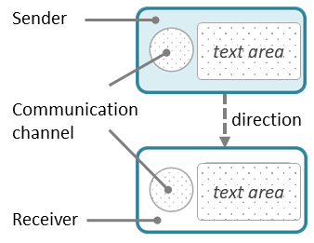

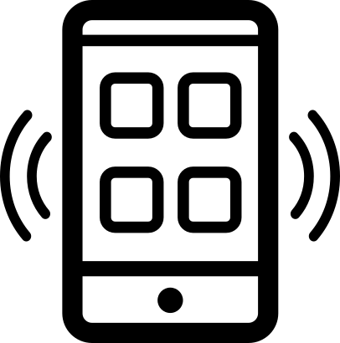



N=3 actors
💡 Select suitable icons for the involved actors and drag them onto the swimlanes (see the Symbol gallery for more options).
💡Position each part of the communication point in the correct swimlane.
💡Insert actions for
non-communicating touchpoints
<describe the action>
<Short text explaining the sending side>
<Short text explaining the receiving side>
<Actor 1>
<Short text explaining the receiving side>
<Short text explaining the sending side>
<Actor 2>
<Short text explaining the receiving side>
<Short text explaining the sending side>
<Actor 3>
💡 Select a channel symbol, drag it onto each side of the touchpoint.
<Short text explaining the sending side>
<Short text explaining the sending side>
<Short text explaining the receiving side>
<Short text explaining the receiving side>
<describe the action>
<describe the action>
<Short text explaining the receiving side>
<Short text explaining the receiving side>
<Short text explaining the sending side>
<Short text explaining the sending side>
<describe the action>
27

Slide 28

N=3 actors + comments
💡 Select suitable icons for the involved actors and drag them onto the swimlanes (see the Symbol gallery for more options).
💡Position each part of the communication point in the correct swimlane.
💡Insert actions for
non-communicating touchpoints
<describe the action>
<Short text explaining the sending side>
<Short text explaining the receiving side>
<Actor 1>
<Short text explaining the receiving side>
<Short text explaining the sending side>
<Actor 2>
<Short text explaining the receiving side>
<Short text explaining the sending side>
<Actor 3>
This is a comment for this specific touchpoint
This is a comment for this specific touchpoint
Comment
💡 Select a channel symbol, drag it onto each side of the touchpoint.
<Short text explaining the sending side>
<Short text explaining the sending side>
<Short text explaining the receiving side>
<Short text explaining the receiving side>
<describe the action>
<describe the action>
<Short text explaining the receiving side>
<Short text explaining the receiving side>
<Short text explaining the sending side>
<Short text explaining the sending side>
<describe the action>
28

Slide 29
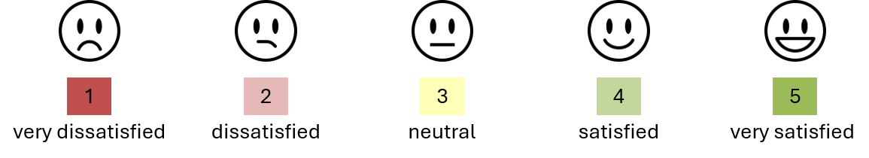
N=3 actors + end user experience
💡 Select suitable icons for the involved actors and drag them onto the swimlanes (see the Symbol gallery for more options).
<describe the action>
<Short text explaining the sending side>
<Short text explaining the receiving side>
<Actor 1>
<Short text explaining the receiving side>
<Short text explaining the sending side>
<Actor 2>
<Short text explaining the receiving side>
<Short text explaining the sending side>
<Actor 3>
<describe the end-user experience>
<describe the end-user experience>
<describe the end-user experience>
Actor 1’s experience
💡 Select a channel symbol, drag it onto each side of the touchpoint.
<Short text explaining the sending side>
<Short text explaining the receiving side>
<describe the action>
💡 Describe the experience and add a symbol.
<describe the end-user experience>
<describe the end-user experience>
<describe the action>
<describe the end-user experience>
<describe the end-user experience>
<Short text explaining the receiving side>
<Short text explaining the sending side>
<describe the action>
29

Slide 30
N=4 actors
💡 Select suitable icons for the involved actors and drag them onto the swimlanes (see the Symbol gallery for more options).
💡Position each part of the communication point in the correct swimlane.
💡Insert actions for
non-communicating touchpoints
<describe the action>
<Short text explaining the sending side>
<Short text explaining the receiving side>
<Actor 1>
<Short text explaining the receiving side>
<Short text explaining the sending side>
<Actor 2>
<Short text explaining the receiving side>
<Short text explaining the sending side>
<Actor 3>
<Actor 4>
💡 Select a channel symbol, drag it onto each side of the touchpoint.
<Short text explaining the sending side>
<Short text explaining the sending side>
<Short text explaining the receiving side>
<Short text explaining the receiving side>
<describe the action>
<describe the action>
<Short text explaining the receiving side>
<Short text explaining the receiving side>
<Short text explaining the sending side>
<Short text explaining the sending side>
<describe the action>
30

Slide 31
N=4 actors + comments
💡 Select suitable icons for the involved actors and drag them onto the swimlanes (see the Symbol gallery for more options).
<describe the action>
<Short text explaining the sending side>
<Short text explaining the receiving side>
<Actor 1>
<Short text explaining the receiving side>
<Short text explaining the sending side>
<Actor 2>
<Short text explaining the receiving side>
<Short text explaining the sending side>
<Actor 3>
<Actor 4>
This is a comment for this specific touchpoint
This is a comment for this specific touchpoint
Comment
💡 Select a channel symbol, drag it onto each side of the touchpoint.
<Short text explaining the sending side>
<Short text explaining the sending side>
<Short text explaining the receiving side>
<Short text explaining the receiving side>
<describe the action>
<describe the action>
<Short text explaining the receiving side>
<Short text explaining the receiving side>
<Short text explaining the sending side>
<Short text explaining the sending side>
<describe the action>
31

Slide 32
N=4 actors + end user experience
💡 Select suitable icons for the involved actors and drag them onto the swimlanes (see the Symbol gallery for more options).
<describe the action>
<Short text explaining the sending side>
<Short text explaining the receiving side>
<Actor 1>
<Short text explaining the receiving side>
<Short text explaining the sending side>
<Actor 2>
<Short text explaining the receiving side>
<Short text explaining the sending side>
<Actor 3>
<Actor 4>
<describe the end-user experience>
<describe the end-user experience>
<describe the end-user experience>
Actor 1’s experience
💡 Select a channel symbol, drag it onto each side of the touchpoint.
<Short text explaining the sending side>
<Short text explaining the sending side>
<describe the action>
💡 Describe the experience and add a symbol.
<describe the end-user experience>
<describe the end-user experience>
<describe the action>
<describe the end-user experience>
<describe the end-user experience>
<Short text explaining the receiving side>
<Short text explaining the receiving side>
<describe the action>
32

Slide 33
Journey phase: plain
Phase 1
Phase 2
Phase 2
Journey phase: detailed
Booking of appointment
Outpatient clinic
April 13th 1 p.m.
April 27th
April 30th
Journey phase and touchpoint ID
Phase 1
Phase 2
Phase 2
T1
T2
T3
T4
T5
T6
<describe the action>
<Short text explaining the sending side>
<Short text explaining the receiving side>
<Short text explaining the sending side>
<Short text explaining the sending side>
<Actor 1>
<Short text explaining the receiving side>
<Short text explaining the sending side>
<Short text explaining the receiving side>
<Actor 2>
<Short text explaining the receiving side>
<Short text explaining the sending side>
<Short text explaining the receiving side>
<Actor 3>
33

Slide 34
Compliance
Compliance can be addressed for actual journeys when the planned journey is known.
The touchpoint boundary style indicates its status, as illustrated below.
To highlight deviations from a planned journey, consider using a deviation diagram.
Normal
Ad-hoc
Failing
Missing
<Short text explaining the sending side>
💡
Journey network diagrams are generally not suitable for sequence errors.
<Short text explaining the receiving side>
34

Slide 35
Healthcare: N=4 actors
💡 Select suitable icons for the involved actors and drag them onto the swimlanes (see the Symbol gallery for more options).
💡Position each part of the communication point in the correct swimlane.
💡Insert actions for
non-communicating touchpoints
<describe the action>
<Short text explaining the sending side>
<Short text explaining the receiving side>
<Actor 1>
<Short text explaining the receiving side>
<Short text explaining the sending side>
<Actor 2>
<Short text explaining the receiving side>
<Short text explaining the sending side>
<Actor 3>
<Actor 4>
💡 Select a channel symbol, drag it onto each side of the touchpoint.
<Short text explaining the sending side>
<Short text explaining the sending side>
<Short text explaining the receiving side>
<Short text explaining the receiving side>
<describe the action>
<describe the action>
<Short text explaining the receiving side>
<Short text explaining the receiving side>
<Short text explaining the sending side>
<Short text explaining the sending side>
<describe the action>
35

Slide 36
Healthcare: N=4 actors + comments
💡 Select suitable icons for the involved actors and drag them onto the swimlanes (see the Symbol gallery for more options).
<describe the action>
<Short text explaining the sending side>
<Short text explaining the receiving side>
<Actor 1>
<Short text explaining the receiving side>
<Short text explaining the sending side>
<Actor 2>
<Short text explaining the receiving side>
<Short text explaining the sending side>
<Actor 3>
<Actor 4>
This is a comment for this specific touchpoint
This is a comment for this specific touchpoint
Comment
💡 Select a channel symbol, drag it onto each side of the touchpoint.
<Short text explaining the sending side>
<Short text explaining the sending side>
<Short text explaining the receiving side>
<Short text explaining the receiving side>
<describe the action>
<describe the action>
<Short text explaining the receiving side>
<Short text explaining the receiving side>
<Short text explaining the sending side>
<Short text explaining the sending side>
<describe the action>
36

Slide 37
Healthcare: N=4 actors + patient experience
💡 Select suitable icons for the involved actors and drag them onto the swimlanes (see the Symbol gallery for more options).
<describe the action>
<Short text explaining the sending side>
<Short text explaining the receiving side>
<Actor 1>
<Short text explaining the receiving side>
<Short text explaining the sending side>
<Actor 2>
<Short text explaining the receiving side>
<Short text explaining the sending side>
<Actor 3>
<Actor 4>
<describe the end-user experience>
<describe the end-user experience>
<describe the end-user experience>
Actor 1’s experience
💡 Select a channel symbol, drag it onto each side of the touchpoint.
<Short text explaining the sending side>
<Short text explaining the sending side>
<describe the action>
💡 Describe the patient experience and add a symbol.
<describe the end-user experience>
<describe the end-user experience>
<describe the action>
<describe the end-user experience>
<describe the end-user experience>
<Short text explaining the receiving side>
<Short text explaining the receiving side>
<describe the action>
37

Slide 38


Cybersecurity: N=3 actors + comments
💡 Select suitable icons for the involved actors and drag them onto the swimlanes (see the Symbol gallery for more options).
💡Annotate relevant touchpoints with the appropriate risk level
threat
unwanted incident
<describe the action>
<Short text explaining the sending side>
<Short text explaining the receiving side>
<Actor 1>
<Short text explaining the receiving side>
<Short text explaining the sending side>
<Actor 2>
<Short text explaining the receiving side>
<Short text explaining the sending side>
<Actor 3>
This is a comment for this specific touchpoint
This is a comment for this specific touchpoint
Comment
💡 Select a channel symbol, drag it onto each side of the touchpoint.
<Short text explaining the sending side>
<Short text explaining the receiving side>
<Short text explaining the receiving side>
<Short text explaining the sending side>
38

Slide 39
Data privacy: N=3 actors
💡 Select suitable icons for the involved actors and drag them onto the swimlanes (see the Symbol gallery for more options).
💡Annotate relevant touchpoints where personal data are collected, processed, or shared.
Data collected
Data processed
Data shared
<describe the action>
<Short text explaining the sending side>
<Short text explaining the receiving side>
<Short text explaining the sending side>
<Short text explaining the receiving side>
<Actor 1>
<Short text explaining the receiving side>
<Short text explaining the sending side>
<Short text explaining the receiving side>
<Actor 2>
<Short text explaining the receiving side>
<Short text explaining the sending side>
<Short text explaining the sending side>
<Actor 3>
DC: Description of data collected + purpose
DP: Description of data processed + purpose
DS: Description of data shared + purpose
DC: Description of data collected + purpose
DP: Description of data processed + purpose
DS: Description of data shared + purpose
DC: Description of data collected + purpose
DP: Description of data processed + purpose
DS: Description of data shared + purpose
DC: Description of data collected + purpose
DP: Description of data processed + purpose
DS: Description of data shared + purpose
DC: Description of data collected + purpose
DP: Description of data processed + purpose
DS: Description of data shared + purpose
DC: Description of data collected + purpose
DP: Description of data processed + purpose
DS: Description of data shared + purpose
Privacy Comment
💡 Select a channel symbol, drag it onto each side of the touchpoint.
<Short text explaining the sending side>
<Short text explaining the receiving side>
<describe the action>
💡 Describe the relevant information and place the box onto the privacy swimlane
DC: data collection (+ purpose)
DP: data processing (+ purpose)
DS: data sharing (+ purpose)
Select and insert the appropriate symbol.
DC: Description of data collected + purpose
DP: Description of data processed + purpose
DS: Description of data shared + purpose
<describe the action>
<Short text explaining the receiving side>
<Short text explaining the sending side>
<describe the action>
39

Slide 40
Examples – customer journey diagram
Online bookstore:
Planned journey
Actual journey with deviations and customer experience

Slide 41


Online bookstore: Planned journey (1/2)
A customer orders books through an online bookstore. The bookstore coordinates the payment with a financial partner, who sends an invoice to the customer. After payment, the bookstore sends the package to the customer.
The planned journey consists of the following touchpoints:
T1: The customer orders books online through the bookstore’s web application.
T2: The financial partner sends the invoice to the customer.
T3: The customer pays the invoice.
T4: The customer receives the books.
T1
T2
T3
T4
orders a book
online
receives order invoice
pays the invoice
receives package in the mailbox
Initiated by
Customer
Online store
Financial partner
41

Slide 42
Online bookstore: Actual journey (2/2)
Tom’s actual journey consists of the following touchpoints:
T1: Tom orders books online through the bookstore’s web application.
T2: Tom receives the invoice from the financial partner.
D2.1: Tom discovers a hidden delivery fee when reviewing the invoice.
D2.2: Tom calls the financial partner to clarify the amount and realizes that he was not attentive when ordering the books. Tom is now dissatisfied as the fee was not presented more clearly.
T3: Tom pays the invoice.
T4: Tom receives the package in his mailbox.
T1
T2
T3
T4
orders a book
online
receives order invoice
pays the invoice
receives package in the mailbox
Tom
Customer finds
the price information misleading
D2.1
"I did not like the hidden fee"
D2.2
dissatisfied
Calls to question the amount
42

Slide 43
Examples – journey network diagram
Online bookstore:
Planned journey
Actual journey with deviations and customer experience
Healthcare:
Referral to a specialist
Booking difficulties for an MS patient
Cybersecurity
Data privacy

Slide 44


Online bookstore: Planned journey (1/2)
A customer orders books through an online bookstore. The bookstore coordinates the payment with a financial partner, who sends an invoice to the customer. After payment, the bookstore sends the package to the customer.
The planned journey consists of the following touchpoints:
T1: The customer orders books online through the bookstore’s web application.
T1.1: The bookstore receives the order and forwards it to their financial partner.
T2: The financial partner sends the invoice to the customer.
T3: The customer pays the invoice.
T3.1: The financial partner confirms the payment to the online store (This step is not part of the customer’s journey.)
T4: The customer receives the books.
T1
T1.1
T2
T3
T3.1
T4
orders a book online
receives order invoice
pays the invoice
receives package in the mailbox
Customer
receives the order
sends the payment details
receives the confirmation of payment
sends package to the customer
Online
store
receives the payment details
sends order invoice
receives payment
sends the confirmation of payment
Financial
partner
44

Slide 45

Online bookstore: Actual journey (2/2)
Tom’s actual journey consists of the following touchpoints:
T1: Tom orders books online through the bookstore’s web application.
T2: Tom receives the invoice from the financial partner.
D2.1: Tom reviews a hidden delivery fee when studying the invoice.
D2.2: Tom calls the financial partner to clarify the issue and realizes that he was not attentive when ordering the books. Tom is now dissatisfied as the fee was not presented more clearly.
T3: Tom pays the invoice.
T4: Tom receives the package in his mailbox.
T1
T1.1
T2
D2.1
D2.2
T3
T3.1
T4
orders a book online
receives order invoice
finds the amount information misleading
calls to question the amount
pays the invoice
receives package in the mailbox
Tom
receives the order
sends the payment details
receives the confirmation of payment
sends package to the customer
Online
store
receives the payment details
sends order invoice
clarifies amount info
receives payment
sends the confirmation of payment
Financial
partner
💡
Tom’s experience is represented in a separate swimlane.
"I did not
like the
hidden fee"
Tom's Experience
45

Slide 46





Referral from general practitioner to a specialist
Healthcare example
A patient experiencing pain visits a GP, who decides that specialist care is needed and sends a referral. The specialist clinic schedules an appointment and informs the patient. After receiving a reminder, the patient attends the consultation, where the specialist decides that an operation is needed.
Primary care contact
Referral process
Specialist consultation
Feels pain in the limb
Meets for an appointment with GP
Receives information about the appointment
Receives an SMS reminder about the appointment
Consultation with specialist at the out-patient clinic
Patient
Medical examination => need to consult a specialist
Sending an electronic referral to the specialist
GP
Receives the referral and decides to call in the patient
Schedules and issues a letter with information
Sends a reminder about the appointment
Examines the patient, decides for an operation
Specialist
Simplification: this stage involves several actors and steps which are not shown here.
Simplification: this is normally taken care of by a medical coordinator at the specialist's clinic
💡
Comments are placed in a dedicated swimlane
Comment
46

Slide 47






Booking difficulties for an MS patient (1/2)
Healthcare example
Sara, an MS patient, receives regular infusions at an outpatient clinic. She must remember to schedule each new appointment herself. When booking her next appointment, she fails to get through by phone because the telephone service is closed. She has to call again later.
BOOKING OF APPOINTMENT
OUTPATIENT CLINIC
April 13th 1 p.m.
April 18th
April 27th
April 30th
💡
The diagram continues on the next slide.
I need to book a new appointment at the outpatient clinic, but it is already too late.
Calls the outpatient clinic to book an appointment.
Receives a reminder.
Meets at the outpatient clinic.
Sara
General practitioner
Neurologist
Allocates an hour on April 30th.
Sends a reminder.
Takes blood samples and administers infusion.
Nurse, MS clinic
Calling hours are from 8 -11 a.m. This is too limited. I would like to call after lunch time!
I could not have the time that suited me best.
A reminder with date, time, building and link to exact location.
I met a new nurse. He was skilled and very friendly.
Sara's experience
47

Slide 48
Booking difficulties for an MS patient (2/2)
Healthcare example
Sara, an MS patient, receives regular infusions at an outpatient clinic. She must remember to schedule each new appointment herself. When booking her next appointment, she fails to get through by phone because the telephone service is closed. She has to call again later.
    BOOKING OF NEXT APPOINTMENT
May 8th
May 9th
May 9th
May 9th
Visits a MS web resource page with research news.
I realize that it's time to book a new appointment for infusion.
Can't get through to call centre.
Calls the outpatient clinic to book next appointment
for infusion.
Sara
General practitioner
Neurologist
(Telephone system not open)
Reserves an appointment
on May 31st.
Nurse, MS clinic
💡
The patient's experience is represented in a separate swimlane.
Reads about a new promising medicine.
Met an answering machine saying it was outside calling hours (not true)!
Finally – got an appointment on the day I wanted.
Sara's experience
48

Slide 49





Man-in-the-middle-attack
Cybersecurity example
Eric works in an SME developing e-health systems as a customer consultant. Cindy, a general practitioner, has problems uploading patient health records. Eric has brought his laptop to a coffee shop and unknowingly connects to a fake Wi-Fi network. Eric's login credentials for the e-health system are intercepted by the attacker.
E
Eric visits the local coffee shop to do some work on his PC.
Eric unknowingly connects his laptop via the fake WiFi network.
He receives the call and asks for system logs and error messages.
He receives the system logs and error messages.
He logs in to the EHR system to reconfigure the user account.
He explains the error and confirms that it is solved.
Eric (consultant)
The EHR user account is now configured correctly.
EHR system
Cindy has problems when synchronizing new patient information in the EHR system.
She calls Eric, her regular consultant, to solve the problem.
She sends system logs and error messages.
She receives a confirmation that the problem is solved.
Cindy (customer)
In a coffee shop, Eve has set up a fake WiFi connection with a legitimate-sounding SSID.
Eve intercepts the message received by Eric.
Eve intercepts Eric's login credentials to the EHR system.
Eve (attacker)
49

Slide 50
Book purchase
Data privacy example
The scenario follows a buyer purchasing a used book through a C2C marketplace. The buyer places an order, pays by credit card, and receives confirmation from the marketplace that the seller has accepted the request. A delivery partner then handles the shipment and keeps the buyer updated until the book is delivered to the mailbox.
Search and buy
Delivery
Finds a book and requests to buy it
Pays for the book by credit card
Notified that the seller has accepted the request
Notified that the book has been picked up from the seller.
Notified that the package is on its way
Notified that the package is delivered to the mailbox
Buyer
Purchase request registered
Payment registered
Seller acceptance registered
Sends delivery request to delivery partner
C2C marketplace
Receives delivery request
Notifies buyer that the book has been picked up from the seller
Notifies buyer that the package is on its way
Notifies buyer that the package has been delivered to the mailbox
Delivery partner
DC: Product information (book selection)
DP: IP address, device information, contact information (book selection)
DC: Product information, billing address, credit card details (payment)
DP: Contact information, billing address, credit card details (payment)
DP: Product information, contact information, billing address (order fulfillment)
DS: Contact information, billing address, product information (order fulfillment)
DP: Contact information, billing address (delivery)
DP: Contact information, billing address (delivery)
DP: Contact information, billing address (delivery)
Privacy
comment
50

